Slide 1
Methyl Acetate Manufacture
Final Presentation
Team T - Abdul Fayeed, Adarsh Kannan, Gavin Guerrera Advisors: Dr. Bert Diemer and Dr. Christopher J. Roberts
May 16th, 2022

Slide 2
Topics Covered
Recommendation for process route and catalyst
Background for the project
Comparison of process route
Catalyst Comparison
Benefit of CO recycle
Process Flow Diagram (PFD)
Economics analysis
Sensitivity analysis
Risk analysis

Slide 3
Recommendations
Chose Carbonylation route with mordenite catalyst
We do not require purchasing MeOAc from the DMAC recovery plant
Transfer price = $1,126/tonnes, NPV = $5MM, NROI = 25%, IRR = 27%,
NPC = $300MM

Slide 4
Background
Company objective: produce 500 MM ppy acetic anhydride
Requires plant design to produce 375 MM ppy methyl acetate (MeOAc)
Possible routes: Esterification and Carbonylation
Find economically optimal route
Transfer price from DMAC recovery plant: $1,520/tonne
MeOAc+CO→Ac₂O

Slide 5
Background: Carbonylation and Esterification
Esterification
- Reaction: MeOH_{(l)}+ HOAc_{(l)} → MeOAc_{(l)}+ H₂O_{(l)}
- MeOH-MeOAc and MeOH-H₂O azeotrope - HOAc price: $1,720/tonne
Carbonylation
- Reaction 1: 2 MeOH → DME + H₂O
- Reaction 2: DME + CO → MeOAc - Adding gas recycle vs purging

Slide 6
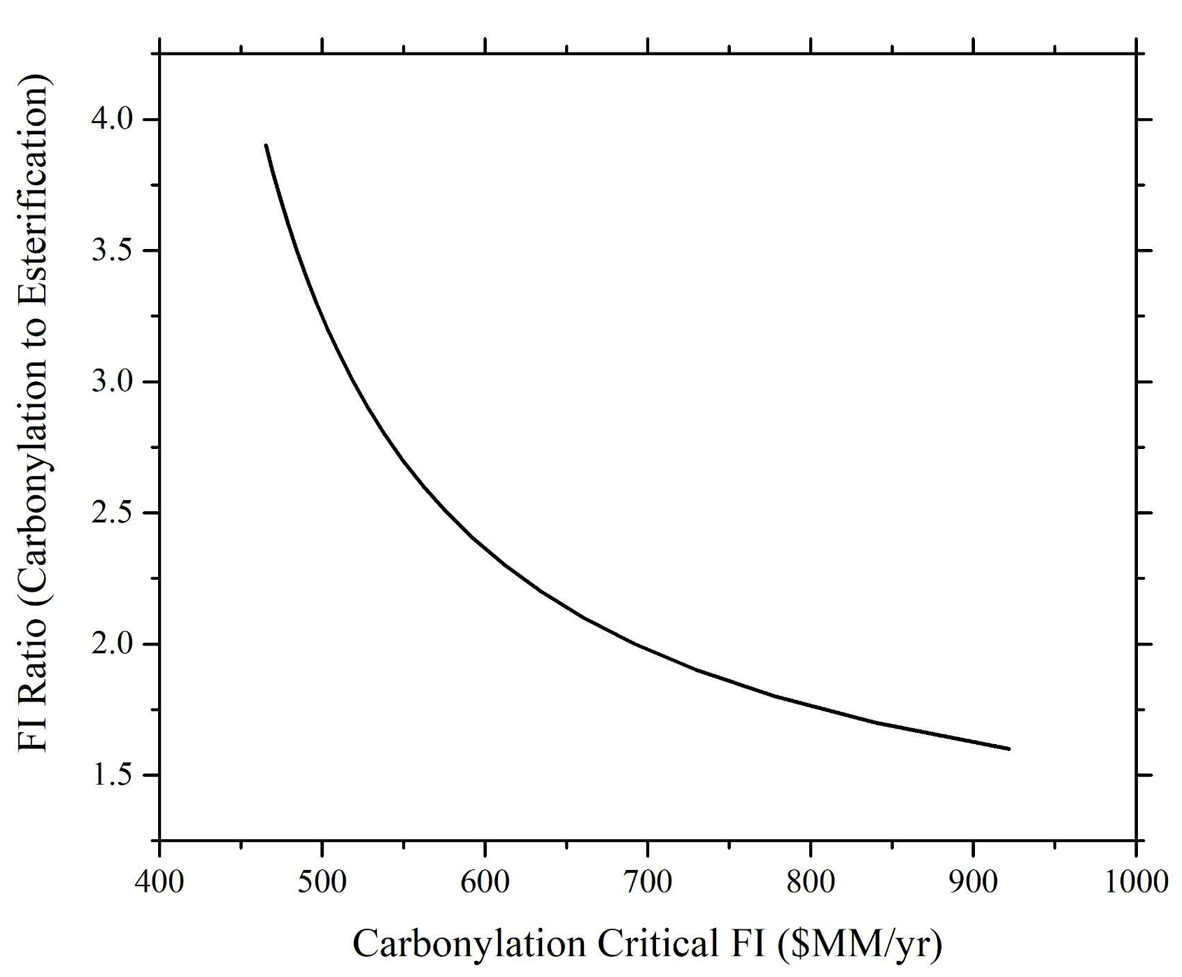
Carbonylation vs Esterification
Carbonylation (worse case): FI = ~$24 MM
Esterification (best case): FI = ~$11 MM
FI Ratio = ~2
Final Optimization (Carbonylation): FI =~$60 MM

Slide 7
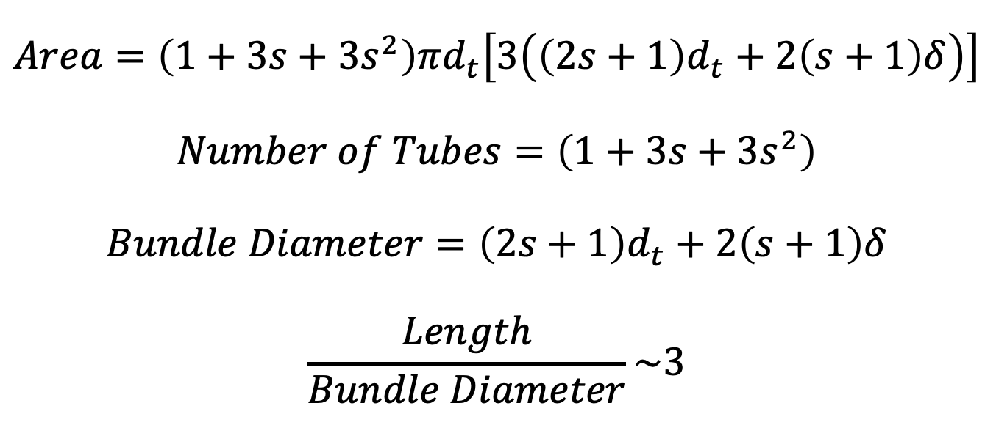
Catalyst: Ion-exchange resin vs H-mordenite
Ion-Exchange Resin |  | H-Mordenite
Catalyst Mass (kg) | 68,000 | Catalyst Mass (kg) | 2,200
Total Catalyst Cost ($) | 333,000 | Total Catalyst Cost ($) | 154,000
Degradation Temp. (ºC) | 100 | Degradation Temp. (ºC) | 400
Catalyst Cost ($/kg) | 4.90 | Catalyst Cost ($/kg) | 70
Reactor Cost ($MM/yr) | 8.10 | Reactor Cost ($MM/yr) | 0.24
2 MeOH DME + H₂O

Slide 8
CO Recycle and Purge
Material | Value
Original CO purge (kmol/hr) | 270
CO purge (recycle) (kmol/hr) | 110
Original Cost ($MM) | 12.40
Updated Cost ($MM) | 5.00
Additional H₂ (kmol/hr) | 100
Cost of H₂ ($MM) | 3.20
Additional Cartalyst ($MM) | 1.30
Savings ($MM) | 2.90

Slide 9
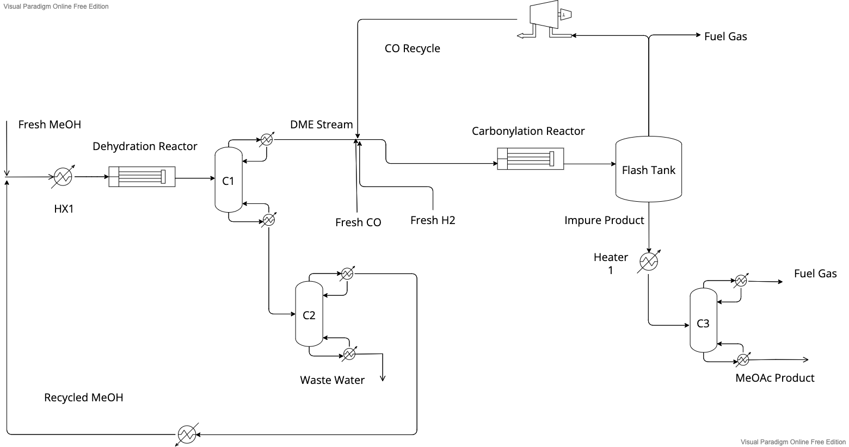
Pre-Heat Integration PFD

Slide 10
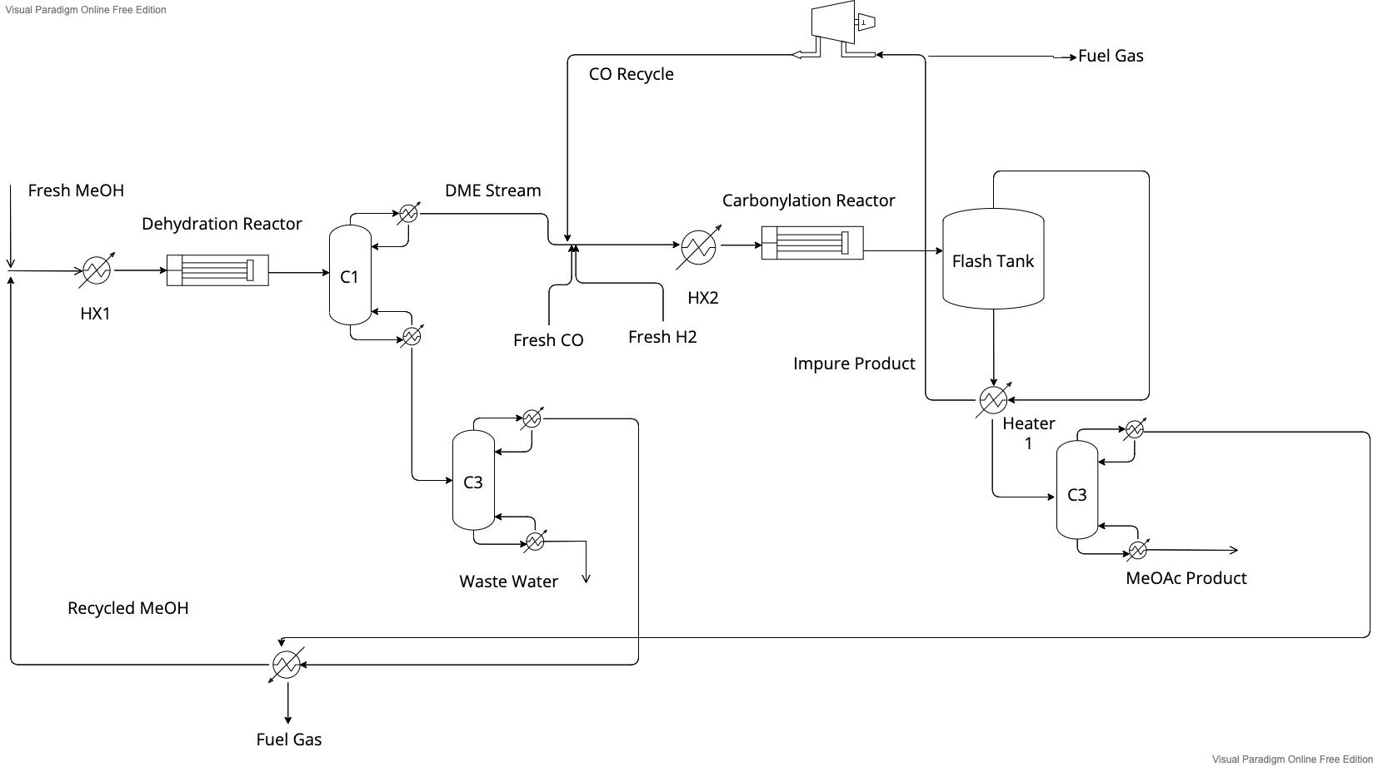
Post-Heat Integration PFD
Utilities ($MM/yr)
Type | Pre-HI | Post-HI
Steam | 2.16 | 1.13
Electricity | 0.06 | 0.05
Refrigerant | 1.20 | 0.40
Cooling Water | 0.18 | 0.18
Total | 3.60 | 1.76
Save 51% in utility costs!

Slide 11
Final Cost Estimations
Equipment Costs
Variable Costs
Equipments | Cost ($MM/yr)
Reactor 1 | 0.24
Reactor 2 | 10.29
Reboiler 1 | 0.03
Condenser 1 | 0.08
Reboiler 2 | 0.04
Condenser 2 | 0.04
Reboiler 3 | 0.08
Condenser 3 | 0.10
Flash tank | 0.10
Heater 1 | 1.46
Heater 2 | 2.32
Heater 3 | 0.82
Heater 4 | 1.19
Compressor | 1.75
Column 1 | 0.86
Column 2 | 0.50
Column 3 | 0.86
Total C_{BM} | 20.76
Ingredients
Type | Cost ($MM/yr)
MeOH | 111.13
CO | 20.67
H₂ | 3.27
Catalysts | 2.21
Total | 137.29
Utilities
Type | Cost ($MM/yr)
Steam | 1.13
Electricity | 0.05
Refrigerant | 0.40
Cooling Water | 0.18
Total | 1.76
Fuel Credits
Type | Cost ($MM/yr)
Waste Fuel | 3.12
VGA = $63MM/yr VC = $142MM/yr
Catalysts = $5.6MM/yr
Key Metrics | Values | Units
TP | 1,126 | $/tonnes
NPV | 5 | $MM/yr
NROI | 25.00 | %
IRR | 27.47 | %
NPC | 300 | $MM/yr

Slide 12
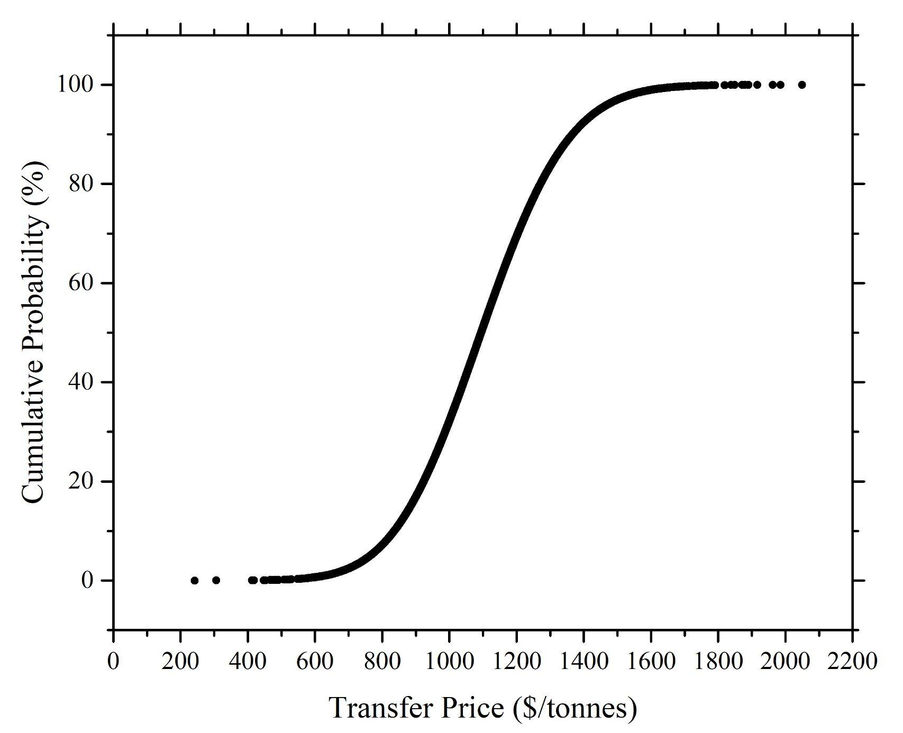
Monte Carlo Simulation on Transfer Price
Significant Parameters | Variations (%)
Production Rate | 10
VGA | 10
Tax Rates | 10
Operator’s wage | 10
Price of MeOH, CO, and H₂ | 10
Yield of MeOH, CO, and H₂ | 2
Min = $200/tonnes
Max = $2,100/tonnes
Range = $1,900/tonnes
Median = $1,100/tonnes

Slide 13
Materials of Construction
Carbon steel used as construction material
Has a yield strength of 600 MPa
Highest pressure : 30 bar
Hydrogen embrittlement occurs above 400ºC and 25 bar
Might need austenitic stainless steel.
Hydrogen purged out via flash tank in process.

Slide 14
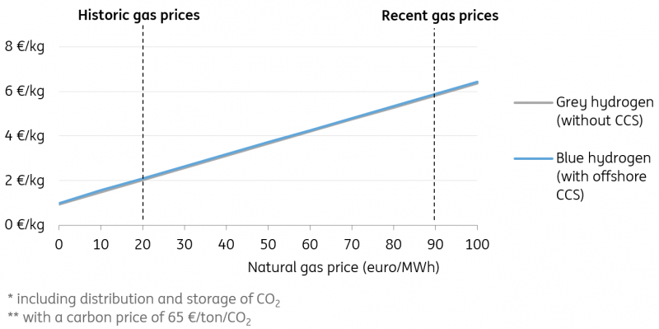
Technical Risk: H₂ Supply
Gerben Hieminga, N. T. High gas prices triple the cost of hydrogen production.

Slide 15
Risk Analysis
Risk | Probability | Consequence | Mitigation Step | Probability after Mitigation | Consequence after Mitigation
Pressure Buildup | 15% | Equipment Failure | Pressure Relief Valves, Pressure Sensors | <5% | Reduced Pressure buildup with alarms for emergency
Chemical Leak | 10% | Fines, Hazardous Material to Atmosphere | Alarm Systems, Relief Valves/Controls | <5% | More alert workforce who can quickly stop a leak with relief systems
Methanol Contamination | 25% | Fines, Harm to surrounding wildlife and drinking water | Water Treatment | <5% | Costs from treatment but reputation saved.
MeOAc-Methanol azeotrope | 20% | Lack of pure final product resulting in significant economic loss | Mitigated by utilizing high pressure to ensure the azeotrope is not formed | <5% | Incurs penalty of additional equipment costing but ensures product purity.
Effect of purging Methane and CO | 100% | Greenhouse gasses would lead to global warming; CO is also toxic | Mitigated by partial flashing to obtain fuel credit | <15% | Improves the reputation of the company, reduces the effect of global warming.

Slide 16
Risk Analysis (Cont’d)
Risk | Probability | Consequence | Mitigation Step | Probability after Mitigation | Consequence after Mitigation
Large Amount of CO is purged | 55% | Significant economic impact on plant operations | Addition of recycle stream | <10% | Incurs slight increase in COM but also leads to acceptable purge of Methane and CO
Effect of Feeding Additional Hydrogen Gas | 100% | Hydrogen is highly flammable | Ensure gas is secured in compressed, stainless steel cylinder | <10% | Prevents explosion and damage to plants.
Hydrogen Embrittlement^{[10]} | 45% | Stress failure of major equipment | Use austenitic stainless steel for the second half of the plant from the carbonylation reactor | <10% | Increases costs, but reduces threat of temporary/permanent plant closure

Slide 17





Chemical Safety
Chemical | Exposure Limit (ppm) | Hazards | PPE Required
MeOH | 200 |  | Safety Glasses, Work Boots, Chemical Resistant Gloves, Overalls
DME | 1000 |  | Safety Glasses, Work Boots, Work Gloves, Overalls
H₂O | N/A | N/A | Safety Glasses, Work Gloves & Boots, Overalls
H₂ | N/A |  | Safety Glasses, Face Shield, Work Boots, Chemically Resistant Gloves
CO | 200 |  | Safety Glasses, Work Boots, Work Gloves,Overalls
CH₄ | N/A |  | Safety Glasses, Work Boots, Work Gloves, Overalls

Slide 18
Conclusions
Move forward with the project
Approximately 5% probability of transfer price going over $1,520 benchmark
Key Metrics | Values | Units
TP | 1,126 | $/tonnes
NPV | 5 | $MM/yr
NROI | 25.00 | %
IRR | 27.47 | %
NPC | 300 | $MM/yr

Slide 19
References
Gerben Hieminga, N. T. High gas prices triple the cost of hydrogen production.
Gates; Johanson. Dehydration of methanol in catalytic fixed bed reactor ... - researchgate. https://www.researchgate.net/publication/349608669_Dehydration_of_Methanol_in_catalytic_fixed_bed_reactor_Dehydration_of_Methanol_in_catalytic_fixed_bed_reactor (accessed May 12, 2022).
Bandiera, J.; Naccache, C. Kinetics of methanol dehydration on delluminated H-mordenite: Model with acid and basic active centres. https://www.sciencedirect.com/science/article/abs/pii/S0166983400832972 (accessed May 12, 2022).
Cheung, P.; Bhan, A.; Sunley, G. J.; Law, D. J.; Iglesia, E. Site requirements and elementary steps in dimethyl ether carbonylation catalyzed by acidic zeolites. https://www.sciencedirect.com/science/article/abs/pii/S002195170600337X (accessed May 12, 2022).
Dimethyl ether - linde US. https://www.lindeus.com/-/media/corporate/praxairus/documents/sds/dimethyl-ether-c2h6o-safety-data-sheet-sds-p4589.pdf?la=en&rev=b0b5f63ac92c4372a7429997926a451c (accessed May 12, 2022).
Methanol Safety Data Sheet - Fisher SCI. https://beta-static.fishersci.com/content/dam/fishersci/en_US/documents/programs/education/regulatory-documents/sds/chemicals/chemicals-p/S25501.pdf (accessed May 12, 2022).
Hydrogen Safety Data Sheet- Airgas. https://www.airgas.com/msds/001026.pdf (accessed May 12, 2022).
Carbon Monoxide Safety Data Sheet - Airgas. https://www.airgas.com/msds/001014.pdf (accessed May 12, 2022).
Methane Safety Data Sheet -Airgas . https://www.airgas.com/msds/001033.pdf (accessed May 12, 2022).
Water Safety Data Sheet - Fisher SCI. https://beta-static.fishersci.com/content/dam/fishersci/en_US/documents/programs/education/regulatory-documents/sds/chemicals/chemicals-p/S25501.pdf (accessed May 12, 2022).
Züttel, A. Materials for hydrogen storage. https://www.sciencedirect.com/science/article/pii/S1369702103009222 (accessed May 12, 2022).

Slide 20
Supplemental Slides

Slide 21
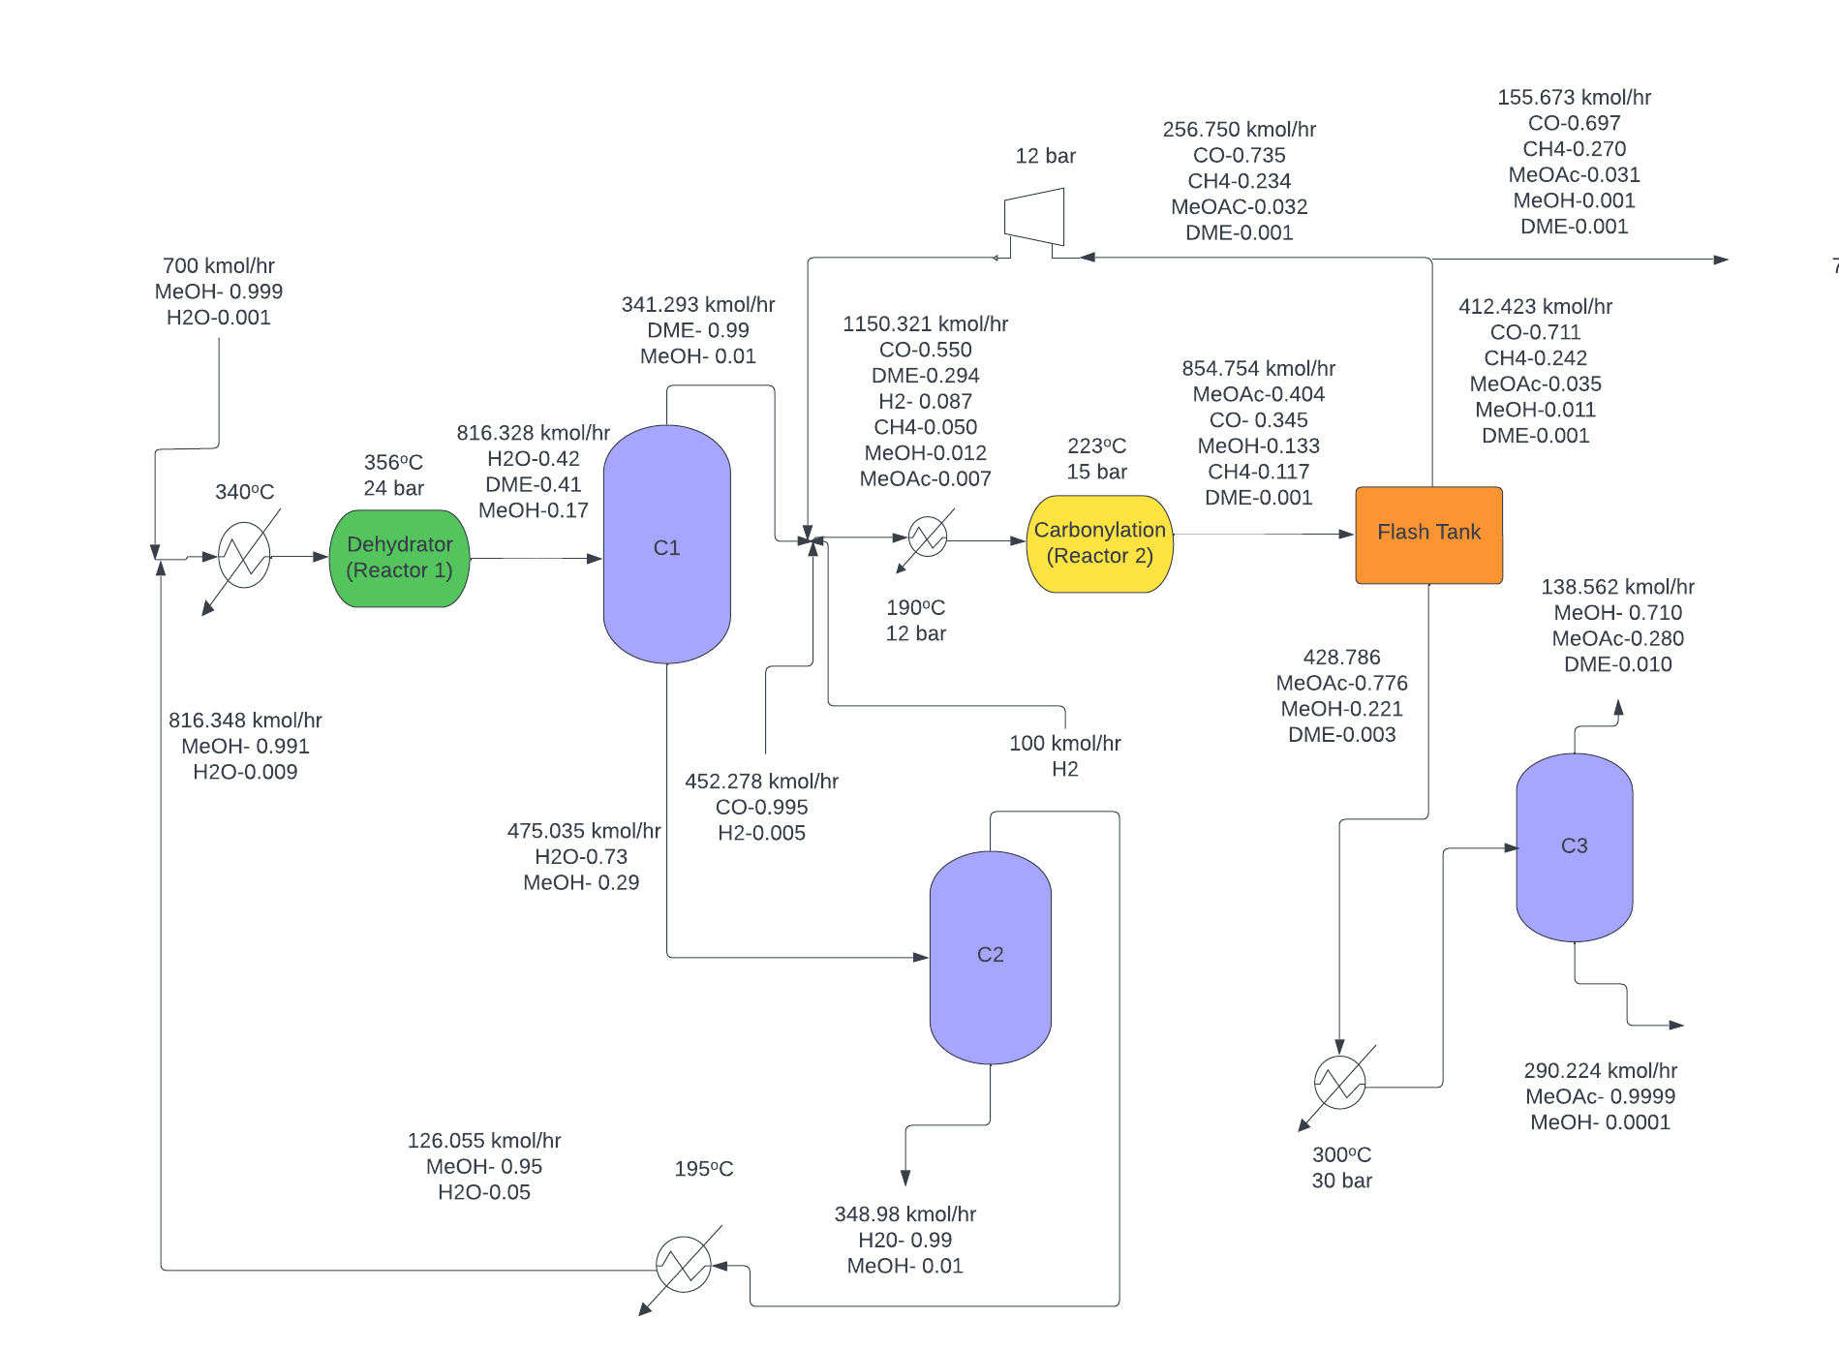
PFD with Stream Flows

Slide 22
Temperature-Pressure Conditions
Parameter | Temperature(ºC) | Pressure (bar)
Heater 1 | 195 | 10
Reactor 1 | 356 (Highest Temp from profile) | 24
Heater 2 | 195 | 10
Mixer | - | 5
Heater 3 | 195 | 5
Reactor 2 | 223 (Highest Temp from profile) | 15
Flash Tank | 14 | 4
Heater 3 | 300 | 30
Compressor | - | 12
Condenser 1 | 139.90 | -
Condenser 2 | 127.00 | -
Condenser 3 | 179.90 | -
Reboiler 1 | 32.00 | -
Reboiler 2 | 95.00 | -
Reboiler 3 | 25.00 | -

Slide 23
Temperature-Pressure Conditions (Distillation Columns)
Parameter | Value
Column C1 Pressure | 7 bar
Column C1 D/F Ratio | 0.43
Column C1 Reflux Ratio | 5
Column C1 Stages | 15
Column C1 Feed Stage | 6
Reboiler Type | Total reboiler
Column C2 Pressure | 3 bar
Column C2 D/F Ratio | 0.25
Column C2 Reflux Ratio | 2
Column C2 Stages | 15
Column C2 Feed Stage | 5
Reboiler Type | Total reboiler
Column C3 Pressure | 20 bar
Column C3 D/F Ratio | 0.145
Column C3 Reflux Ratio | 20
Column C3 Stages | 15
Column C3 Feed Stage | 6
Reboiler Type | Partial reboiler

Slide 24
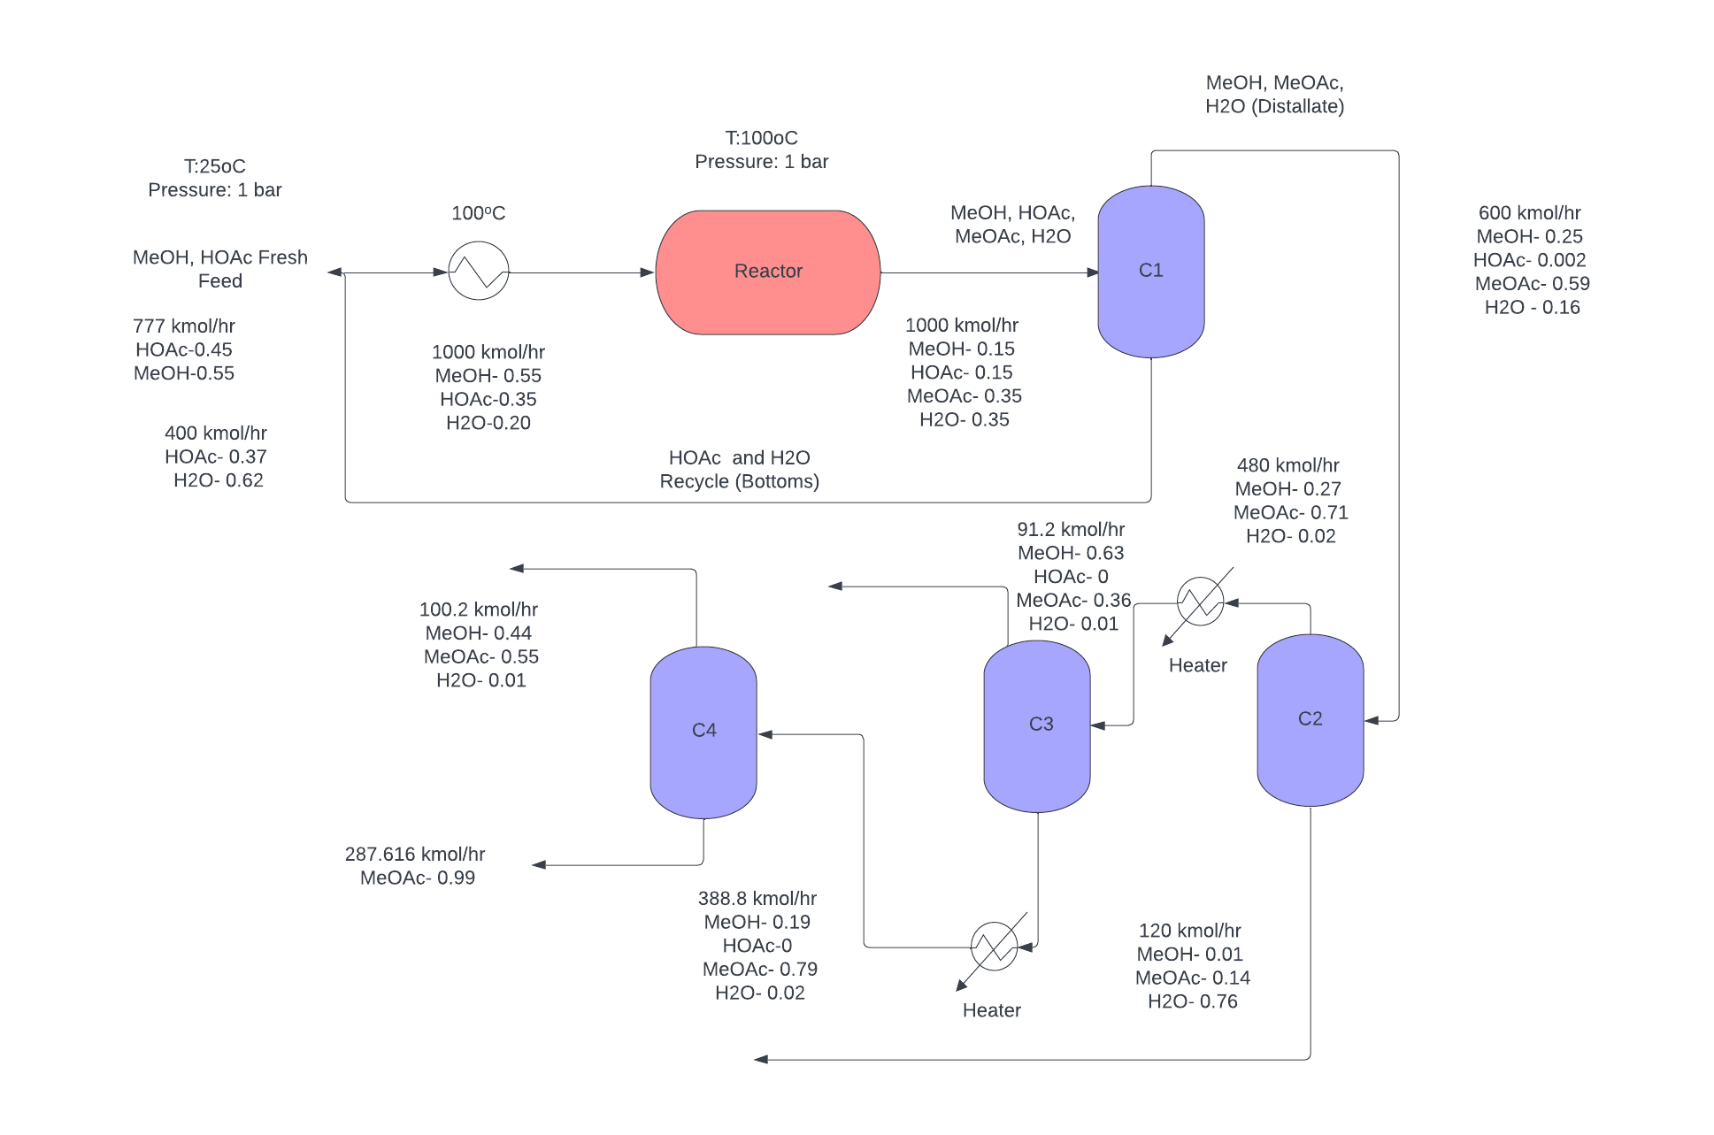
Esterification Sample BFD

Slide 25
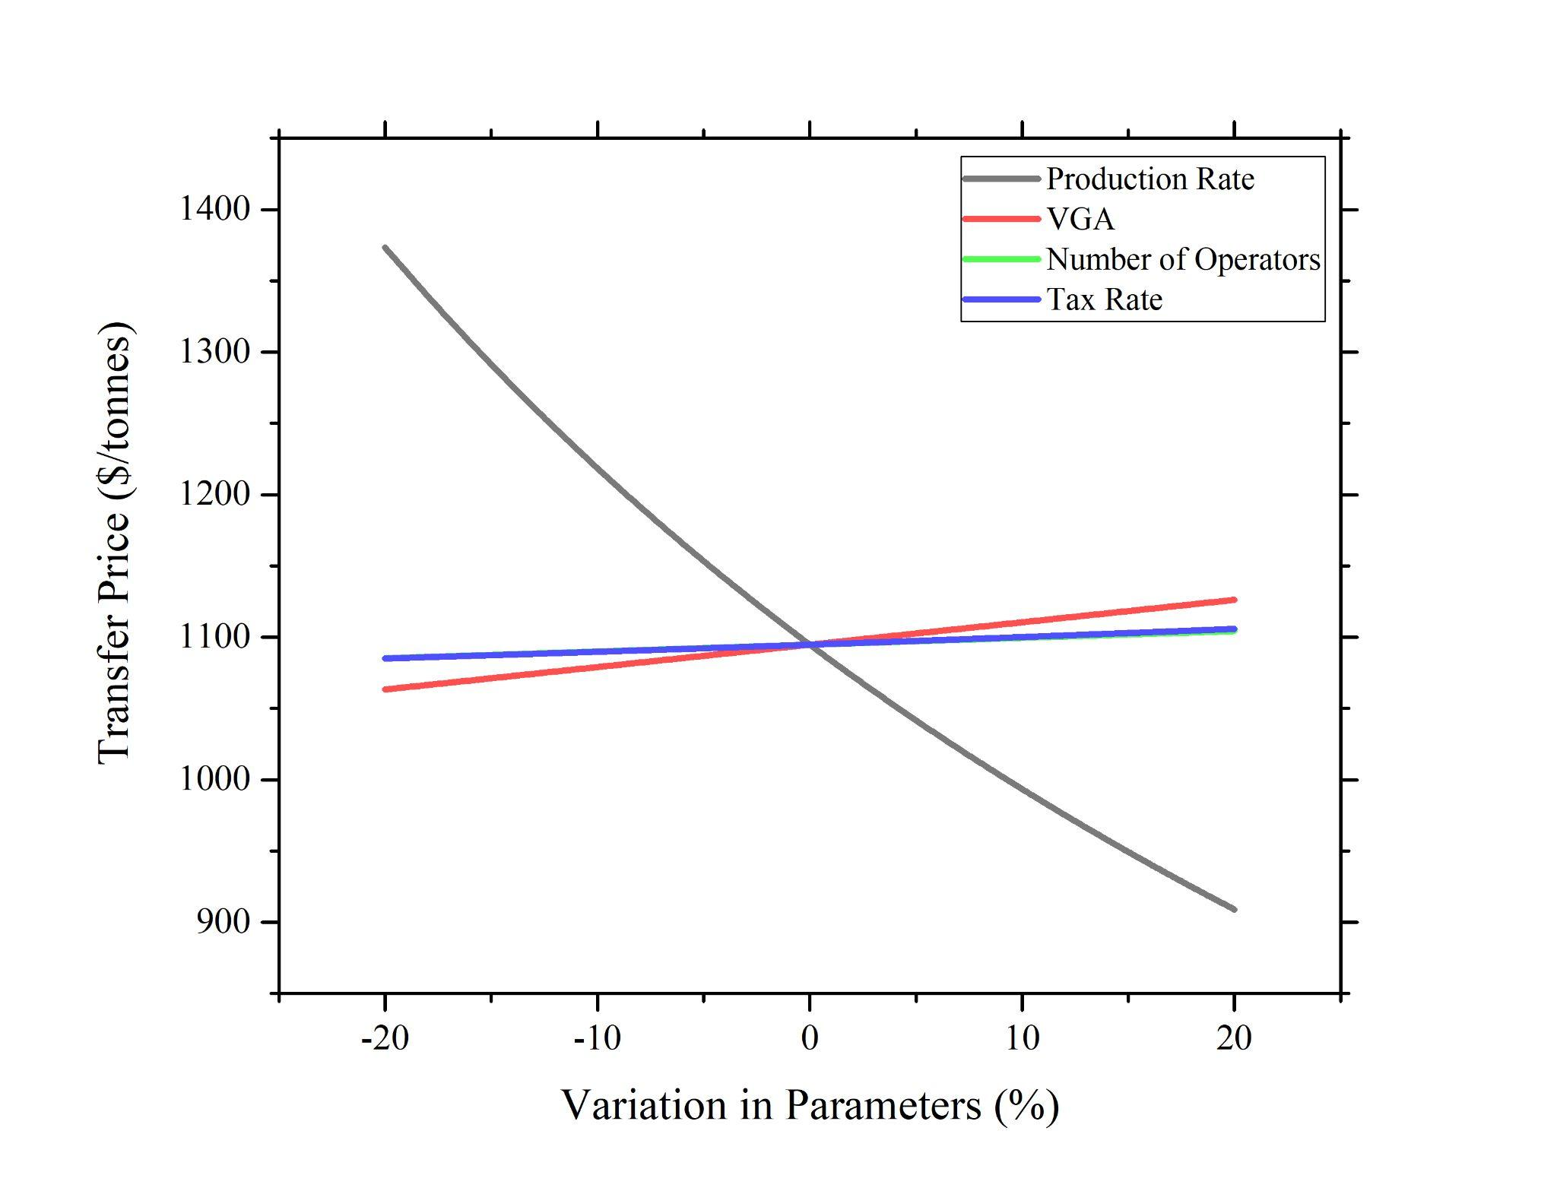
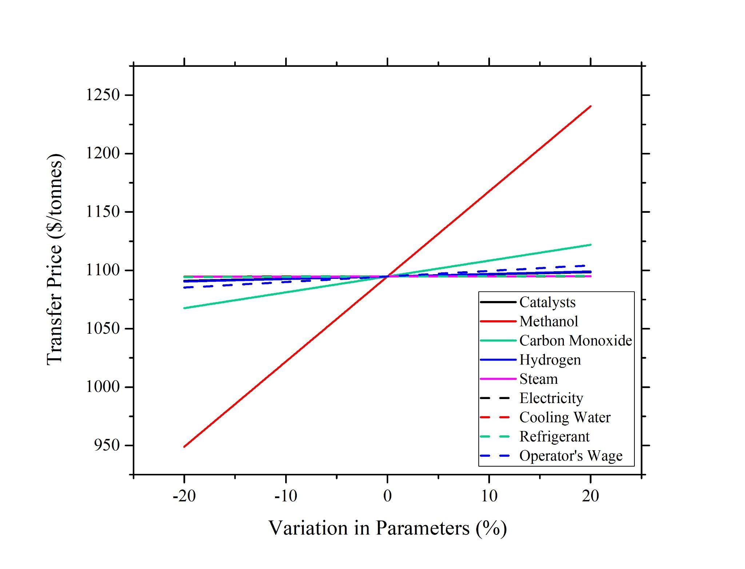
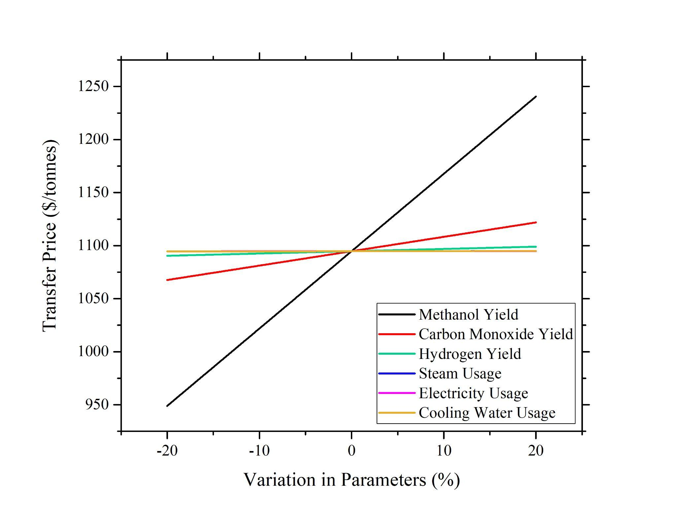
Sensitivity Analysis

